Slide 1
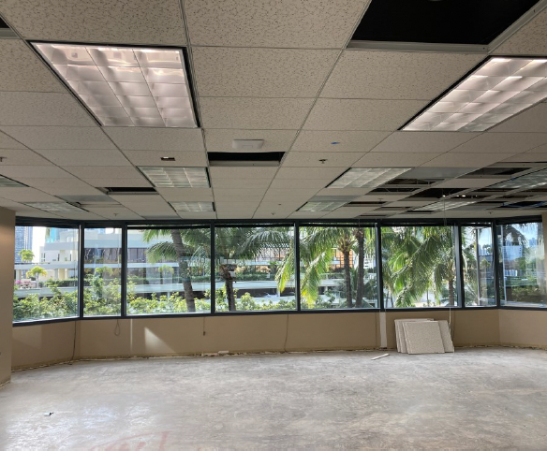

LumiSight Hoteling App KickOff
February 14, 2022

Slide 2
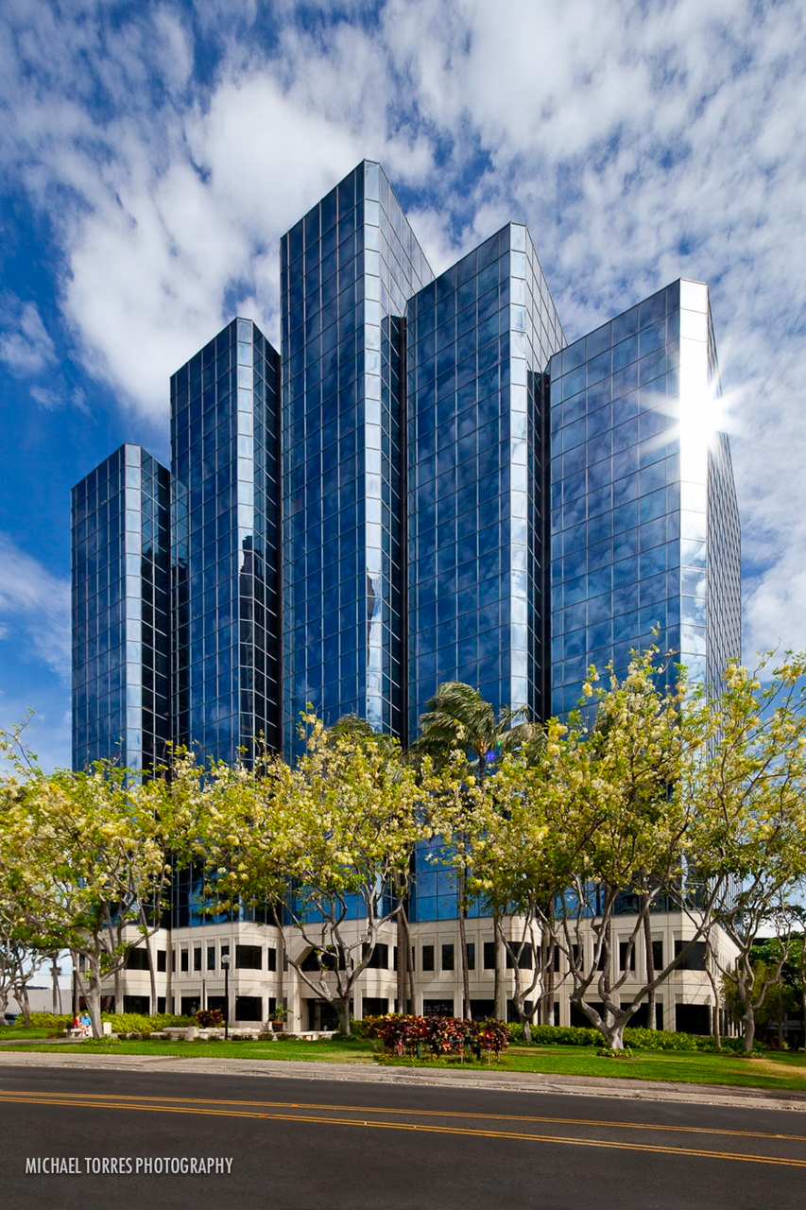

Today's Agenda
  Welcome
  Introductions
  Project & Current Situation
  Phase 1
  Timeline
  Getting Started

Slide 3
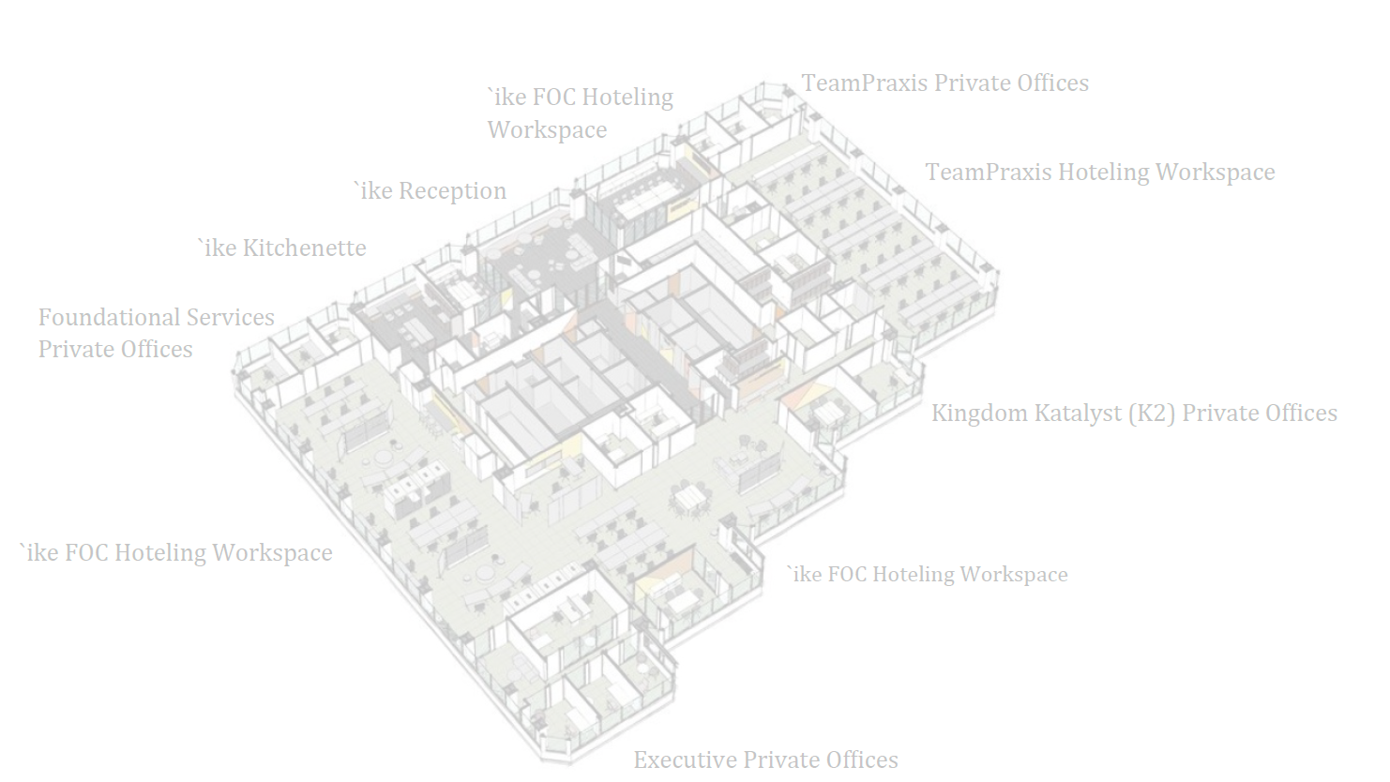
Introductions

Slide 4
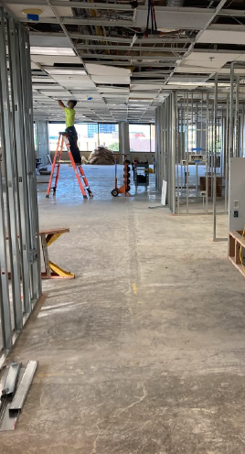
About the Project
  'Ike family of companies is condensing into one office space at beginning of April
    'Ike, DataHouse, Team Praxis
  Solutions on the market do not cater to the needs
  Developing the future of the LumiSight Platform
  Roughly 8 weeks to complete Phase 1

Slide 5
Project Team
Clyde Shiigi
Project Sponsor
Ky Pham
Product Owner
Alyssa Mencel
Project Manager
Jegnesh Gehlot
Mentor/Developer
Jordan Takemoto
Mentor/Developer
Riley Sodetani
Mentor/ Developer
Alvin Edrada
Back End Intern
Taylor Gabatino
Front End Intern
Timothy Huo
Back End Intern

Slide 6
Phase 1
Account Management
  Transfer current user pool and login component from LumiSight
Office Space
Reservation Management
  Employees can make a reservation for a desk or room
  View their reservations
  Cancel their reservations
  Export reservation to Outlook
  Admin receives notification of reservation
  Admin can cancel reservation
  View a Map of Workspaces
  Upload a Map of Workspaces
  Manage Desks/ Rooms (CRUD)
Admin Dashboard
  View upcoming reservations
  Filter reservations

Slide 7
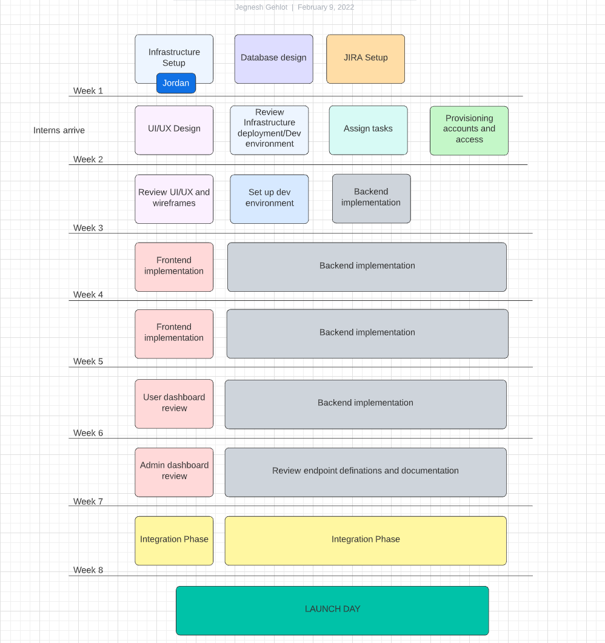

Slide 8

Getting Started

