Slide 1
It’s Always Day 1
Amazon’s approach to Innovation
Stephen Brozovich
Principal Evangelist
Amazon Web Services

Slide 2


Slide 3

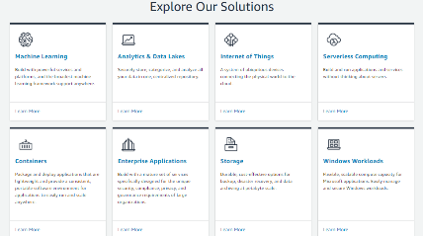


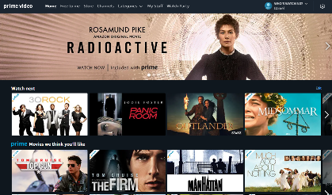

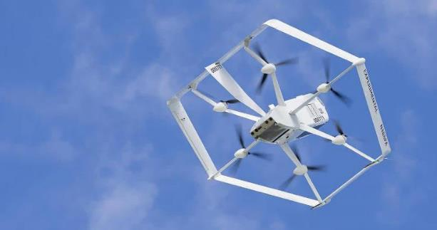

E-commerce
Devices
Streaming Content
Consumables
Drone Delivery

Slide 4
Our Mission
to be Earth’s most customer-centric company

Slide 5
What is a Day 1 culture?
Notes:
So what is a Day 1 culture? At Amazon, we think a Day 1 culture has many aspects to it, but there are three main ones we’ll focus on here – a relentless focus on customers, the right culture that supports employees in making high quality, high judgment decisions at speed, and empowers them with the permission to experiment early and often, fail and learn from those failures, and be bold and disruptive in their innovations.

Slide 6
Day 1
Mission Focused
Agile
Experimental
Disruptive
Day 2
Internally Focused
Deliberate
Risk Averse
Protective

Slide 7
What are the warning signs of a Day 2 culture?
Notes:
Now that we’ve spent some time looking at aspects of a Day 1 culture, it’s natural to ask the question, what does Day 2 look like? In his 2018 letter to Shareholders, Jeff Bezos gave his opinion:
“Day 2 is stasis, followed by irrelevance, followed by excruciating, painful decline. Followed by death.”

Slide 8





Day 2: Focused on process, not customer outcomes
vs
Notes:
Day 2 companies become obsessed with process. Day 1 companies create processes, but the key metrics they use to test whether or not a process is working are grounded in the direct impact to the customer.

Slide 9
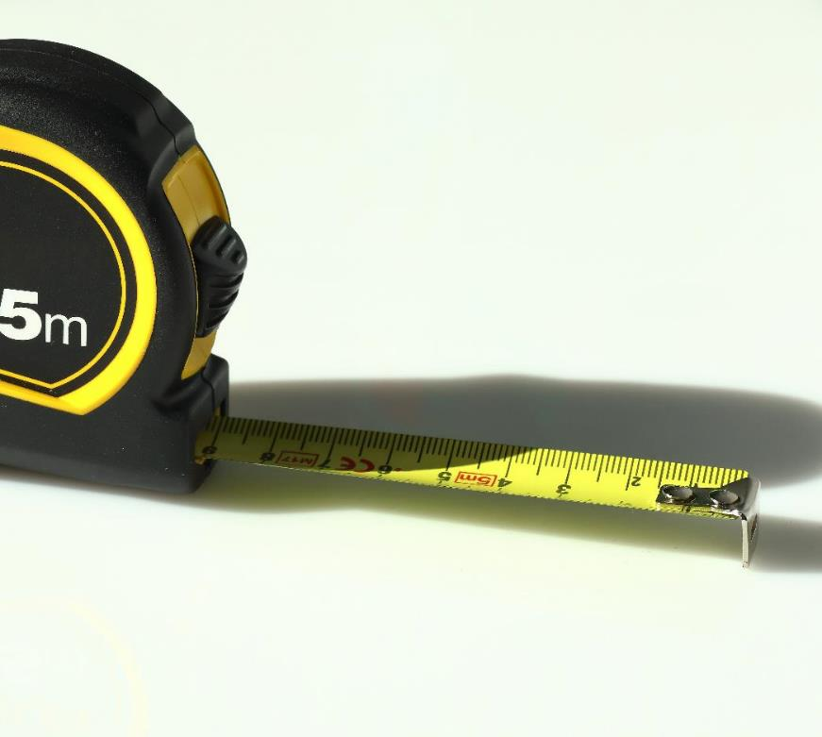

Day 2: Focus on short-term measureable results vs. long term customer delight
vs
Notes:
Short term thinking also has a direct impact on the ability to invent. Environments that are focused on short term objectives are less tolerant of mistakes. We don’t leave room for the iteration that’s needed to test an idea. In fact, we tend to deprioritize experimentation in favor of those initiatives that have a direct impact on our short-term goals.

Slide 10









Day 2: Approval vs. autonomy
Hierarchical organization moves decision makers further away from customers
Fear of failure constrains experimentation
CUSTOMERS
Notes:
To stay a Day 1 company, we have to find a way to hear directly from customers, and incorporate that information into our strategic plans. Unless our plans are informed by this direct customer information, we run the risk of making decisions that seem right for the business, but don’t actually benefit the end customer in any way.

Slide 11
“Day 2 companies make high-quality decisions, but they make high-quality decisions slowly. To keep the energy and dynamism of Day 1, you have to somehow make high-quality, high-velocity decisions.”
Jeff Bezos
Founder Amazon.com, Inc.
2017 Letter to Shareholders
Notes:
I want to start this next section with a quote by Jeff Bezos from Amazon’s 2017 letter to shareholders.
So how do we do this? How do we retain high judgment decisions at high velocity, especially as we grow?

Slide 12
Notes:
It’s hard to argue with the ideal state of a team.
To get the most out of your team you want to have all members delivering on the right things as quickly as possible. Ideally, this might look like this:

Slide 13
Notes:
But often this is a better version of reality: The team is moving quickly, but not necessarily in the right direction. You’ve got speed, but not velocity. Left unchecked individuals may be hitting goals, but the team as a whole won’t be moving forward very far.

Slide 14
Management / Policy
Notes:
One approach is to make decisions for the team. Team members are encouraged to bring ideas forward, but the manager determines what gets worked on when. This model ensures consistency and direction, but the overall velocity of the team is limited to maximum throughput of the manager’s decision making.
This also provides a strong dis-incentive for team members with new ideas.

Slide 15
Mental Models
Notes:
A more scalable approach is to teach mental models to enable independent decision making. Shared mental models act like a lens and bring focus to the work being done – they lead us to better choices.
The time that leaders invest in helping the their team learn and embody the mental models pays off in greater team autonomy, which in turn, leads to faster delivery – shared mental models can turn speed into velocity.

Slide 16
Mental Models
Unless you know better ones…
Notes:
But better yet is when we use individual viewpoints to help us refine our mental models over time. You’ll find the phrase “…unless you know better ones” scattered all over documents at Amazon. Yes, we have smart people here. Yes, we’ve thought deeply about problems and have good reasons for what we believe we should do. And at the same time, every one of us has blind spots. The only way to get to a better solution than the one we started with is when we are willing to challenge our own assumptions and when we intentionally make space for diverse perspectives.
This type of alignment tends to stick better. We’ve collectively built the mental model together, so buy-in and consensus are almost natural byproducts of the process.

Slide 17


Our Leadership Principles
Customer Obsession
Success and Scale Bring Broad Responsibility
Invent and Simplify
Ownership
Learn and Be Curious
Are Right, A Lot
Insist on the Highest Standards
Hire and Develop the Best
Deliver
Results
Think Big
Bias for Action
Strive to be Earth’s Best Employer
Frugality
Earn Trust
Have Backbone; Disagree and Commit
Dive Deep
https://www.aboutamazon.com/about-us/leadership-principles
Notes:
[Note to presenters: You may want to use a handout with the full LPs in person (https://assets.aboutamazon.com/1d/9b/7aa80cb44794875b3cbbc5185980/amazons-leadership-principles-7.1.21%20(PDF).pdf); or post the link in a videoconference chat – see additional notes further below. Also note updated FAQs available on our wiki – https://w.amazon.com/bin/view/AWS/Teams/Sales-BD/Innovation/ – around the latest two LPs added in July 2021.]
At Amazon, we hold ourselves and each other accountable for demonstrating these 16 Leadership Principles through our actions every day. These Leadership Principles describe how Amazon does business, how leaders lead, and how we keep the customer at the center of our decisions.
This slide shows the headlines of these Leadership Principles – each has a few sentences of descriptive text accompanying them, which you can read by going to the link shown here.
Our Leadership Principles start with Customer Obsession, but there is no hierarchy or order to them. You might notice that there is some tension between principles – taking the time to Dive Deep could slow down Bias for Action. How do you simultaneously Dive Deep and Think Big? We have a principle about disagreeing AND committing.
Our Leadership Principles are not meant to be harmonious – they are meant to be used together to help us make faster, high quality decisions. They serve as guideposts to help us balance priorities at the time we need to make a decision. They help frame conversations where decisions are hard and complex, and force us to look at a problem from many different angles
For example: you need to be biased for action and move fast, but you should dive deep at the right level to inform and validate the approach and mitigate risk. We need to think big and create bold, visionary innovations for customers, but need to dive deep so we have the right details on execution. We encourage employees to have backbone and voice diverse opinions – this fosters rich discussion and gets us to better, long term answers that benefit customers; but once we get to that decision, no matter what side of the discussion we were on, we need to commit to it and focus our energy executing it together.
[Note: You can give a short, non-confidential personal anecdote of a decision where you had to balance two or more LPs]
You’ll also notice that we say “These are our Leadership Principles…unless you know better ones.” Our LPs have remained consistent over time, but they aren’t set in stone – they have changed over time as the company has grown, and as additional. We added Learn & Be Curious in 2015; we also merged a former Leadership Principle about being Vocally Self Critical into Earn Trust. The most recent additions to our LPs occurred on July 1st, 2021, when we added two new principles: Strive to be Earth’s Best Employer, and Success and Scale Bring Broad Responsibility.
We also have a philosophy that everyone in the company is a leader on our mission. And part of that leadership is using these principles every day to help us make better decisions in helping our customers. We use our Leadership Principles pervasively – we use them in our hiring practices in discussing the examples that candidates relate in interviews; they are used to frame the feedback we give each other as peers, and in growth and development conversations between managers and employees. They are a common vernacular that we really do use every day.
Let’s discuss a few of them a little deeper.
[Additional notes if needed/have time:
You can turn this slide into more of a discussion by printing out the Leadership Principles as a handout (https://assets.aboutamazon.com/1d/9b/7aa80cb44794875b3cbbc5185980/amazons-leadership-principles-7.1.21%20(PDF).pdf), or posting the link in a virtual chat (https://www.aboutamazon.com/about-us/leadership-principles), have the customers read them, then lead a discussion – what stood out? What resonated? Do you notice any tension between them? What LPs map to values or tenets the customer has in their organization? What LPs do you think we missing?
Your customer might also have values or similar principles for their company – research and review them as it may foster interesting discussion about where there are commonalities in approach.
Other notes you can leverage:
A big part of what helps LP’s be a part of the fabric of our culture is that they are practical. They are for everyone. They provide words to describe things we want to challenge or feel uncomfortable about. They provide a shared vernacular, and help us create diverse perspectives. They help frame conversations where decisions are hard and complex, force to look at a problem from different angles.
We expect leaders to have judgement and know when to practice these. And different LPs will be more important in different situations, different times in your career. For example, if it’s your first job out of college hire and develop the best is not an emphasis – more about learn and be curious, dive deep, bias for action. For director and VPs, hire and develop the best very important.
ANECDOTE: We originally started with 6 “values,” some of which – notably customer obsession – persist in the 14 current Leadership Principles we have today. But as the company grew, it became apparent that just having values that we socialized just by the nature of working in close proximity with each other was going to be harder as the company scaled – it’s really difficult harder to maintain a culture, and help instill it in new employees joining the company and teach them how to apply those core values as we rapidly grew across different businesses and geographies. So Jeff and his Leadership team spent a fair amount of time codifying them, describing not just what they are but what they look like in action – the result of which were these Leadership Principles and the descriptive text behind them
Additional resources (not to present):
https://broadcast.amazon.com/channels/22025/videos
Beth Galetti and Jeff Wilke discuss the history of LPs: https://broadcast.amazon.com/videos/126744]

Slide 18
Customer Obsession
Leaders start with the customer and work backwards. They work vigorously to earn and keep customer trust. Although leaders pay attention to competitors, they obsess over customers.

Slide 19




Start with the customer
“Who is my customer?”
“How am I making life better for them?”

Slide 20

Work Backwards

Slide 21

Work vigorously to earn and keep customer trust

Slide 22

Competitor aware, customer obsessed!

Slide 23
Ownership
Leaders are owners. They think long term and don’t sacrifice long-term value for short-term results. They act on behalf of the entire company, beyond just their own team. They never say “that’s not my job.”

Slide 24

Be an owner

Slide 25

Think long term

Slide 26

Act on behalf of the entire company

Slide 27

Never say, “That’s not my job”

Slide 28
Invent and Simplify
Leaders expect and require innovation and invention from their teams and always find ways to simplify. They are externally aware, look for new ideas from everywhere, and are not limited by “not invented here”. As we do new things, we accept that we may be misunderstood for long periods of time.

Slide 29

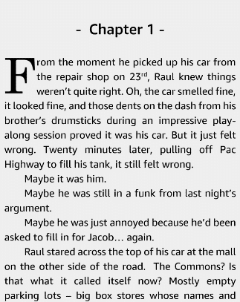

Slide 30


“If the size of your failures isn’t growing, you’re not going to be inventing at a size that can actually move the needle. A single big winning bet can more than cover the cost of many losers.”
-Jeff Bezos, 2018 Amazon Letter to Shareholders
Notes:
Several years ago, we tried launching our own smartphone - the Amazon Fire Phone. It did not do well with customers. In the end we had to write off $170M of unsold hardware. That’s a significant loss. But that kind of loss is going to happen when you’re placing bold bets and taking big risks. In fact, Jeff talked publicly about the Fire phone failure in our 2018 shareholder letter:
“If the size of your failures isn’t growing, you’re not going to be inventing at a size that can actually move the needle. Amazon will be experimenting at the right scale for a company of our size if we occasionally have multibillion-dollar failures. This kind of large-scale risk taking is part of the service we as a large company can provide to our customers and to society. A single big winning bet can more than cover the cost of many losers.”
What gets missed in the story of the fire phone is we weren't just trying to launch a new cell phone. We were trying to change the way humans interact with machines. You know, when touch screen phones launched, it radically changed what we expect from computers. Everything switched from keyboard and mouse to all of a sudden information at my fingertips. And we were just asking ourselves, “How do we make things even simpler than that?” The Fire phone had four forward facing infrared cameras that allowed for extremely sophisticated gesture based interaction with the phone. There was a host of things you could do with the phone without ever having to touch the screen. But it didn't do well with customers. Now when the Fire phone failed, we didn't have mass layoffs. There was no head of marketing or product design that got laid off… We just reinvested.

Slide 31


Slide 32
Working Backwards is a process
Visuals
FAQ
Use it to get clarity, not to document what you’ve already decided to do
Press Release
Customer

Slide 33
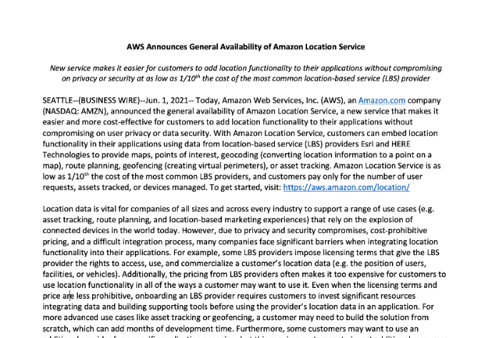
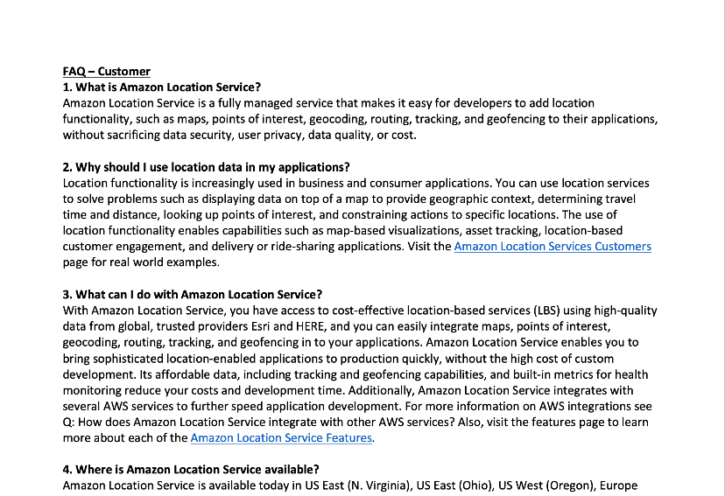
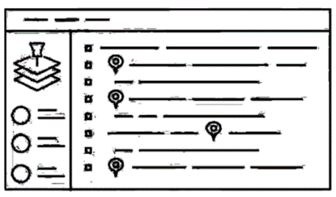
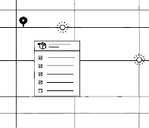

Working Backwards PR/FAQ
Press Release
FAQ
Visuals
Notes:
Before we start any significant development effort and before we put together a team to go build, we test the idea by writing a press release, a set of FAQs, and sometimes even a product manual as if the product has already launched. This process allows us to rapidly test the validity of the idea before we’ve invested heavily in it. Humans have a reluctance to walk away from an investment, even a bad one. And this process lets us test an idea before we start investing in it.
This isn’t a publicly facing press release, but it’s written as if it were. We have to have a believable quote from a customer – would a customer actually say that? And quotes from business leaders talking about the benefits of the new product. And they have to be credible. It’s a lot of hard work, but we’ve found it to be incredibly effective at testing ideas building an enduring vision of the product or feature. There are several direct benefits to the process:
First – it forces you to organize your thoughts. I don’t know about you, but I’ve had a lot of good ideas that turn into mush the moment I try to write them down. I might be excited about an idea, but excitement isn’t a good measure of whether or not something will work. Writing a good press release shifts the focus from enthusiasm about the idea to the quality of the idea itself.
Second – it lets us test how much of a benefit this actually will be for customers. There are a lot of things we could do that are good for the business in the short term that have negligible or negative long-term customer impact, and the press release process really helps us tease out the differences.
Third – when written well, a press release serves as a guiding star for the work once it actually begins. We test our ideas against the press release, or evolve the release itself as we uncover new information about our customers or the technology we’re building. The press release is a valuable way to engage and inform other teams that may need to be involved in the actual project.
Fourth – as mentioned earlier, a press release is actually a small amount of invested energy in an idea that may not pan out. In fact, we expect that a large percentage of press releases don’t lead to a new product or launch because the process itself helped us determine that the idea wasn’t sound. We know that as we invent we will come up with ideas that just won’t work, and we accept that failure is actually a critical part of the process.

Slide 34
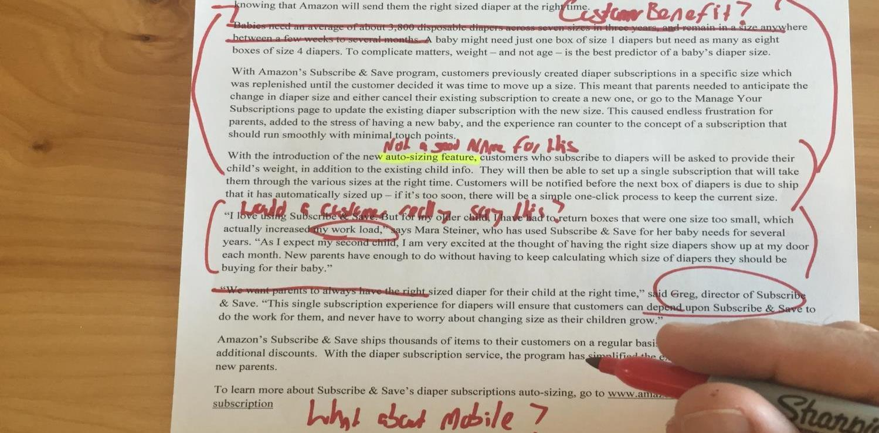
Working Backwards Review

Slide 35
Who is your customer?
How are you making life better for them?

Slide 37
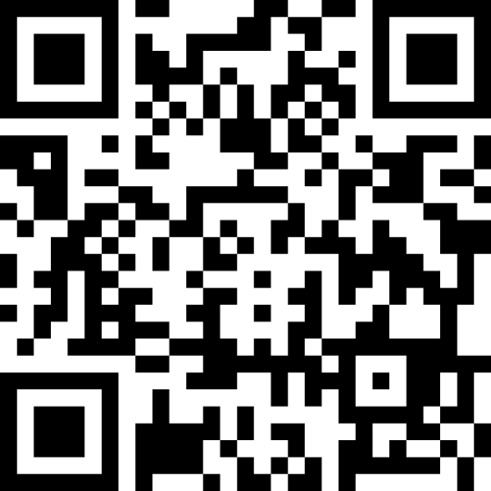
Feedback Please!
URL : https://eventbox.dev/survey/BOIXJJZ
Stephen Brozovich | Principal Evangelist | AWS
Email : sbroz@amazon.com

