Slide 1
How AI/ML Enabled Forecasting Is A Game-Changer for Hawaii's Businesses
Scott Fujieda
Marie Yap
Vice President – Solutions and Services
DataHouse Consulting
Principal Solutions Architect
Amazon Web Services

Slide 2

The Food Waste Problem in Hawai’i
~4% Sales Revenue Lost
237,0000 tons of food wasted in Oahu
$1 Billion
36% organic waste in Landfills
8.7% Inflation price increase
1 https://www.solanacenter.org/business-food-waste
2 https://www.civilbeat.org/2021/11/heres-how-honolulus-climate-office-is-tackling-food-waste/
3 https://www.bls.gov/regions/west/news-release/consumerpriceindex_honolulu.htm#:~:text=Over%20the%20year%2C%20food%20prices,from%20home%20rose%206.8%20percent.

Slide 3


The power of forecasting
WORKFORCE PLANNING
INVENTORY PLANNING
Improve demand planning at granular levels
Reduce waste, increase inventory turns, and improve in-stock availability
More effectively staff to meet varying demand levels
Improve utilization, time to serve, and customer satisfaction
CAPACITY PLANNING
FINANCIAL PLANNING
Make longer term decisions with more confidence
Improve capital utilization
Plan for sales and top-line revenue
Effectively manage cash flows
Notes:
The power of forecasting to address business problems such as food waste

Slide 4






THE CURRENT LANDSCAPE
Customers increasingly want more variety, they want it immediately, and they want it at low cost
Accurate and flexible forecasts are key; however, traditional methods cannot capture the increasing number of demand signals and complexity
Market leaders are investing in ML-driven forecasting to more effectively meet demand
Harvard Business Review, McKinsey Global Institute
https://www.mckinsey.com/business-functions/mckinsey-analytics/our-insights/most-of-ais-business-uses-will-be-in-two-areas
20% accuracy improvements
5% inventory reduction
3% increase in revenue
Notes:
Why we need to use ML instead of traditional methods of forecasting

Slide 5
FORECASTING OVERVIEW
The science of prediction based on historical trends
HISTORICAL TRENDS
FORECAST HORIZON
B
Forecasting seeks to minimize:
Under-forecast errors that results in missed opportunity
Over-forecast errors that result in wasted resources
A
A
B
Notes:
What is forecasting

Slide 6












BASED ON THE TECHNOLOGY THAT POWERS AMAZON.COM
Forecasting is critical to deliver on customer promises
Product availability
Lower price
Fast delivery
Notes:
Why we build Amazon Forecast

Slide 7








BASED ON THE TECHNOLOGY THAT POWERS AMAZON.COM The evolution of forecasting over 20+ years
STATISTICAL METHODS
ML METHODS
ML + DEEP LEARNING
1995
2000
2005
2010
2015
2020
Best for few or independent data (e.g., aggregate demand)
Aggregate demand
Everyday household products
Basic trends
Repeated seasonal patterns
Best for complex and inter-related data (e.g., thousands of SKUs at hundreds of stores)
Regional vs national demand
Subtle seasonal patterns
Relationships between products
New products
Slow moving products
Changing prices or promotions
External events
Notes:
Three phases of forecasting in Amazon evolution

Slide 8

Highly accurate Train and deploy ML models which can be up to 50% more accurate than traditional methods. No deep learning experience required
Fully managed service Easily implement an ML solution at scale by letting Amazon Forecast do all of the heavy lifting of building, training, and deploying a custom ML model in just a few clicks.
Leveraging ML to improve business metrics
The benefits of Amazon Forecast
Easy to use and integrate Add ML forecasting to all you processes by integrating Amazon Forecast into your existing supply chain management systems
Secure: Your data, your models All data is encrypted to be private and secure, and is only used to create recommendations for your customers. Data is not shared between customers or with Amazon.com.
Notes:
What is Amazon Forecast

Slide 9

Problem Description
77 locations in Oahu, Hawaii, Maui
51 Menu Items
Need to predict demand in the next three weeks
Data set – 3 years of weekly data ~500K rows
Notes:
The problem we are solving in our Demo

Slide 10
Demo
Notes:
Switch to Demo

Slide 11






HOW IT WORKS Amazon Forecast
Historical data
Sales, inventory, call volume, resource demand
Amazon
Forecast
Related data Price, promotions,
custom events
Highly accurate forecasts
Forecast explanations
Item metadata Color, city, category, brand, author, size
Built-in datasets
(holidays, weather)
Notes:
What is under the covers

Slide 12
HOW IT WORKS Amazon Forecast
Historical data
Highly accurate forecasts
Related data
Inspect
data and fill gaps
Add built-in data sets
Tune & select hyper-parameters
Train & optimize
models
Select best ensemble of models for each time-series
Calculate accuracy metrics & explainability impact scores
Host
models
Item metadata
Forecast explanations
Fully-managed by Amazon Forecast
Notes:
Behind the Scene

Slide 13
Case Studies

Slide 14
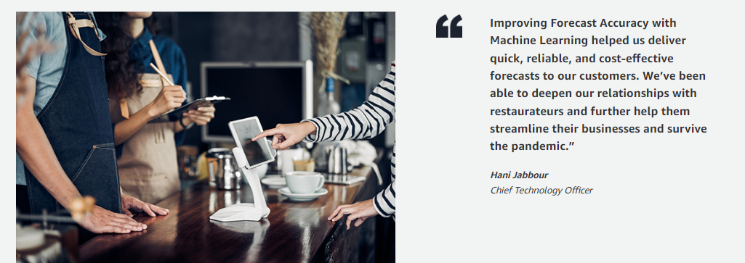
Predicting Restaurant Demand
App8 – Helps Restaurants Predict Demand Using AWS Solutions
Predict how many customers at specific times
How many and which menu items will be in demand
Better manage your inventory – less food waste means a better return on your investment
Notes:
https://aws.amazon.com/solutions/case-studies/app-8/

Slide 15

Workforce planning case study: AffordableTours
AffordableTours – travel sellers of escorted tours, cruises, river cruises, and active vacations in the US
“…By using Amazon Forecast we are now able to anticipate customer demand call volumes to ensure we have the right number of agents each day decreasing our missed call rate by approximately 20%.”
Marc Rosenthal, Senior Project Manager
Affordabletours.com
Award winning service team
Tours across 6 continents
A+ rating with the BBB since 2001
Notes:
AffordableTours.com is a travel sellers of escorted tours, cruises, river cruises, and active vacations in the US. Their customers have a compelling incentive to pick up the phone and call them. They diligently work to offer their customers low prices on travel packages helping them see and experience new wonders. For their business to thrive and to offer even lower prices, they need to find efficiencies everywhere possible. With their global presence they regularly ran into issues having unbalanced resourcing to handle customer call volumes. Some days they had too many agents and other days they had too few which would create inconsistent customer experiences increased our missed call rates and operating costs. By using Amazon Forecast they are now able to anticipate customer demand call volumes to ensure they have the right number of agents each day improving their missed call rate by approximately 20%.

Slide 16
Innovation Canvas Adoption Framework
Why: Turn ideas into an adopted solution
How:
Set the stage
What could we do?
What should we do?
Reminisce forward, work backward
What will we do?
Review, learn, adjust
Operationalize our idea

Slide 17
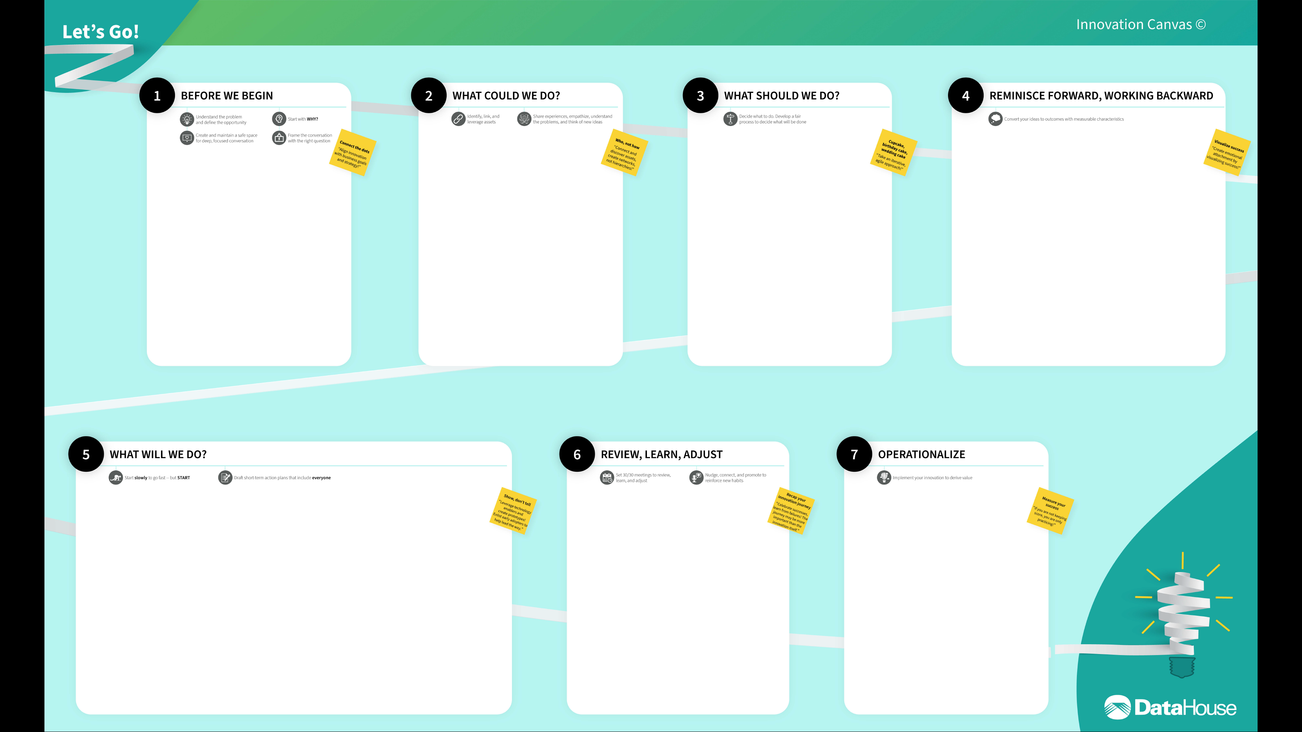
https://www.datahouse.com/i2i
DRAFT

Slide 19

Feedback Please!
URL : https://eventbox.dev/survey/DAQGPUN
Marie Yap| Principal Solutions Architect | AWS
Email : marieyap@amazon.com
Scott Fujieda| Vice President| DataHouse Consulting
Email : scott_fujieda@datahouse.com

