Slide 1

Community Innovation Mentorship Program 3.0: Digital Marketing Toolbox

Slide 2
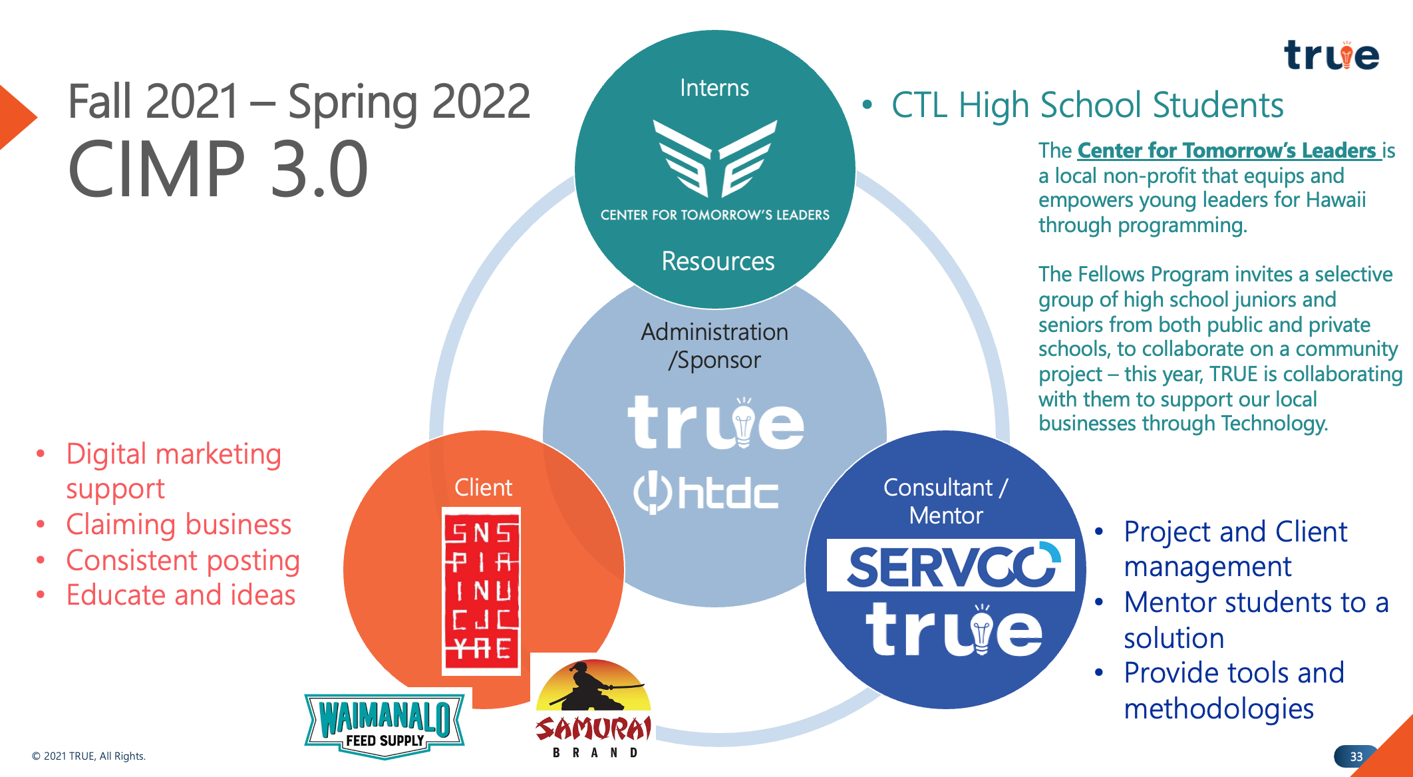
Community Innovation Mentorship Program

Slide 3
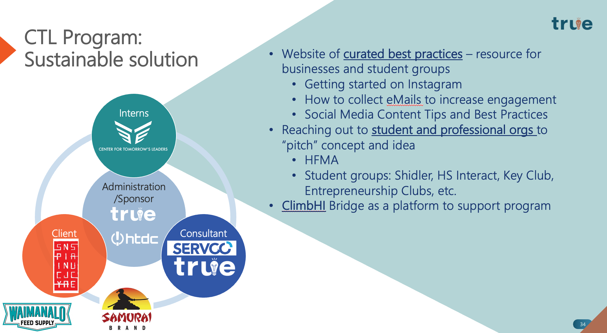
Enable future teams

Slide 4

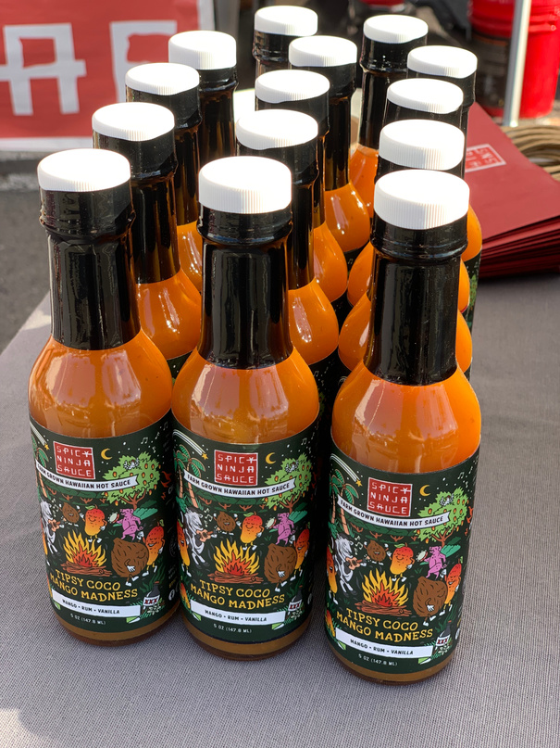
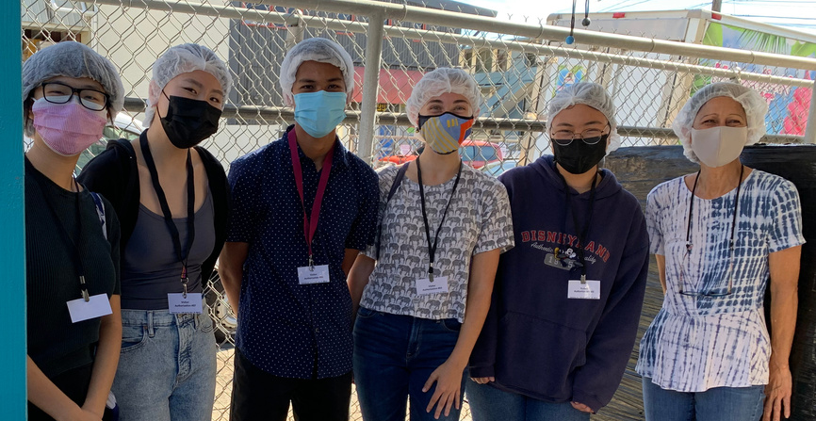
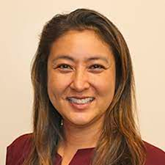


Benefits for Businesses
Enable one local business at a time, while empowering students to leverage their knowledge in the digital economy, supported by a professional.
ROZ F.
JULIE M.
CHRIS
"I'm so grateful for the help the team gave Samurai. We definitely needed the help, and the team was so creative! Now we are doing more posts and social promotions!"
"I really didn't like social media and didn't understand the value of it. Working with the students forced me to look at it from a different perspective. They built the first content calendar, and now I've used it to sync up in-store displays with social posts with promotions."
I need more help and wish they could continue working with me. It's a great learning experience for the students and I need the help because I don't know what i'm doing.

Slide 5
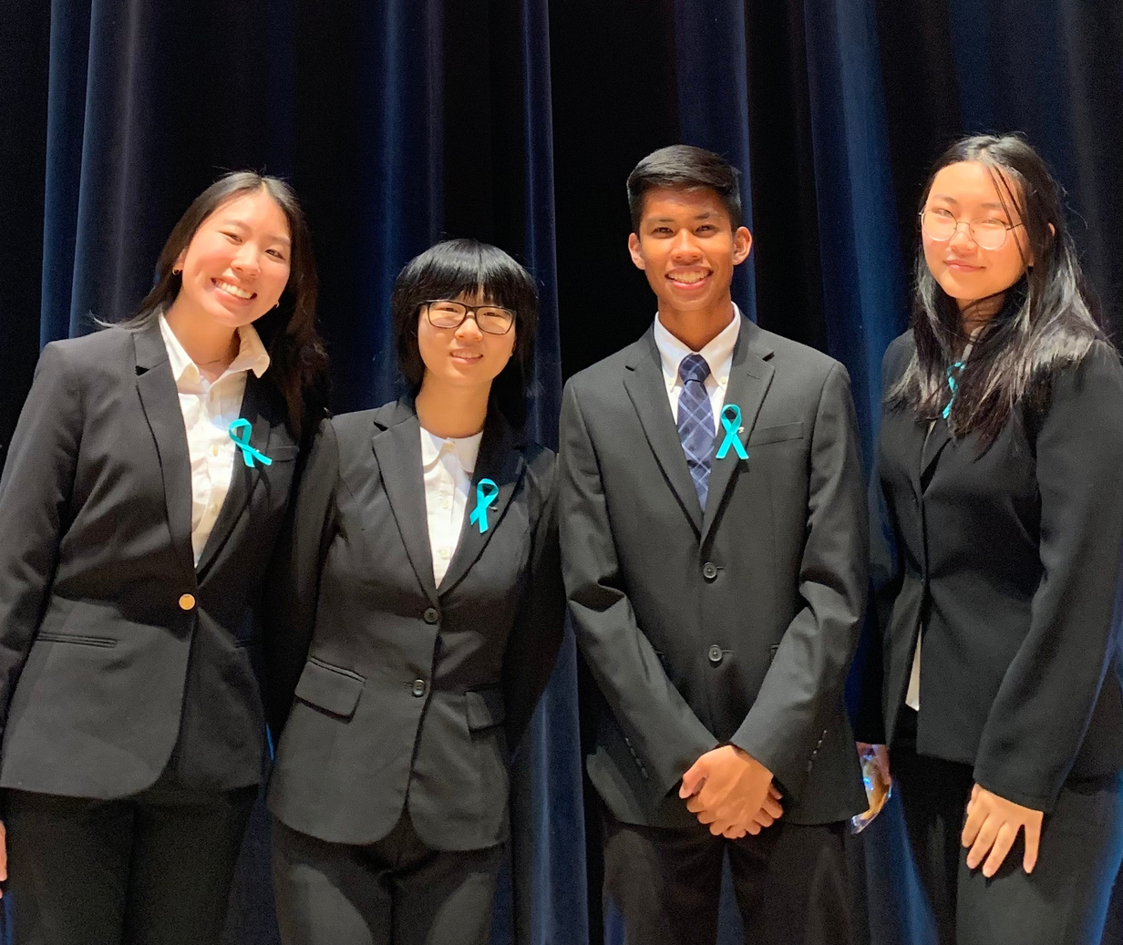
What's Next
CTL Annual Pitch - How we can impact HI
Team beat out 115 teams to be in the finals, which will be aired "Shark Tank" style.
Fri, 4/29 from 8-9pm on K5
Sat, 4/30 from 6-7pm on KGMB
Sun, 5/1 from 3-4pm on KHNL
Hawaii’s Next Chapter: Young Leaders for Tomorrow
Opportunities
DOE: Keith Hayashi
Shidler School of Business - UH
Interact and Key Clubs
Hawaii Food & Manufacturer's Association (HFMA)

